Slide 1

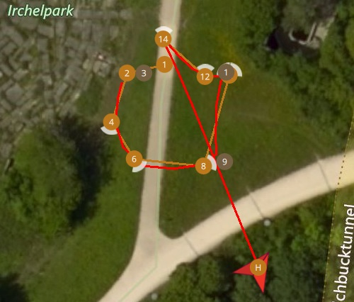
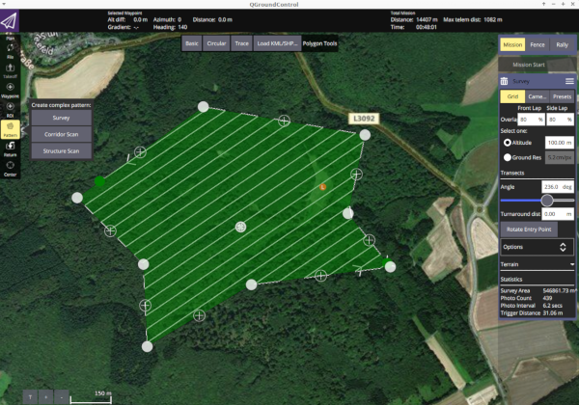
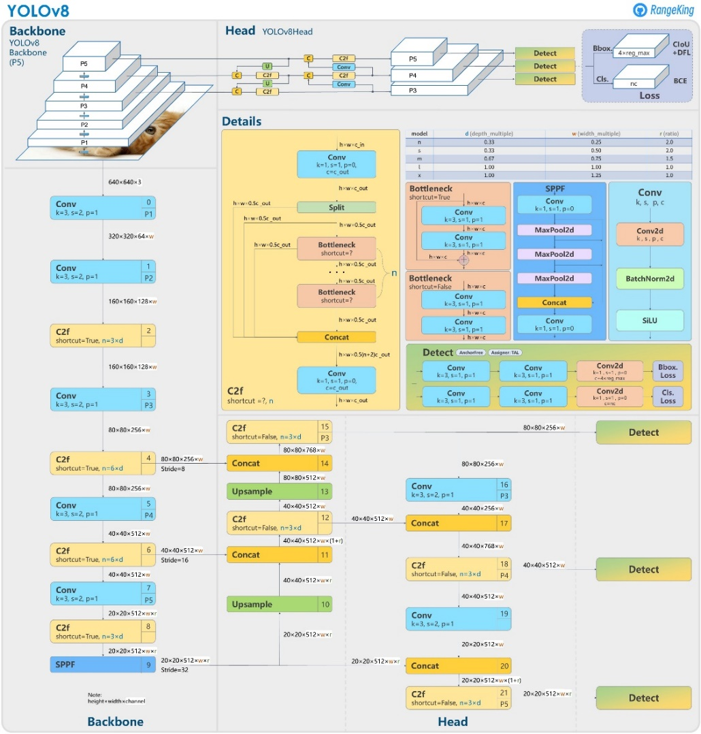
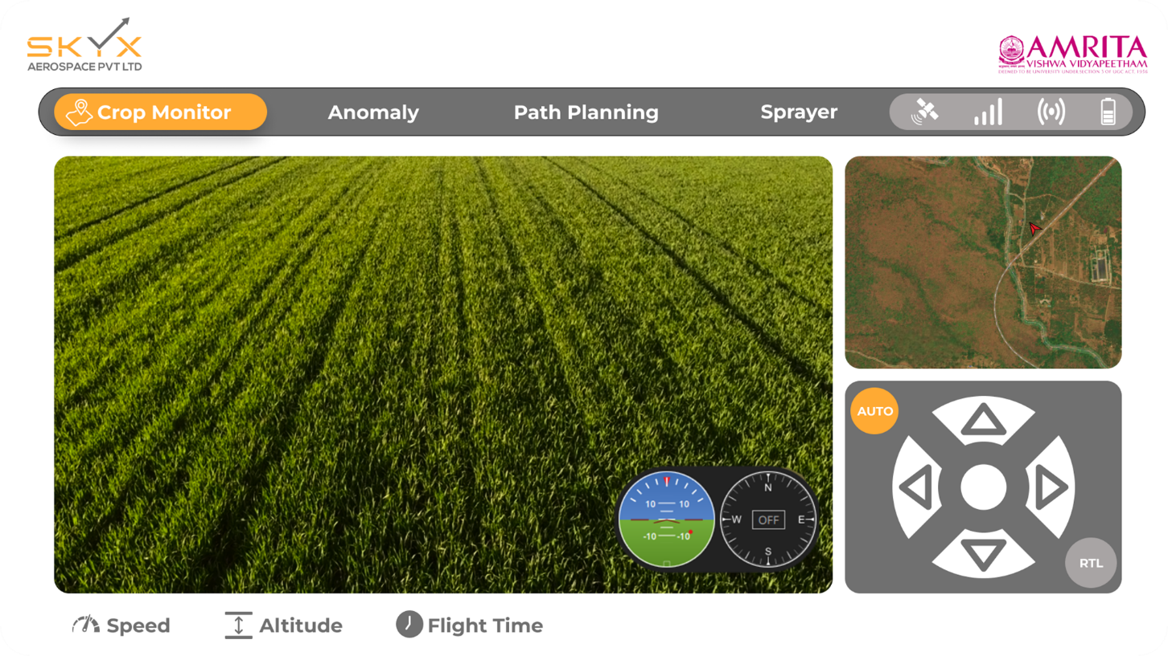
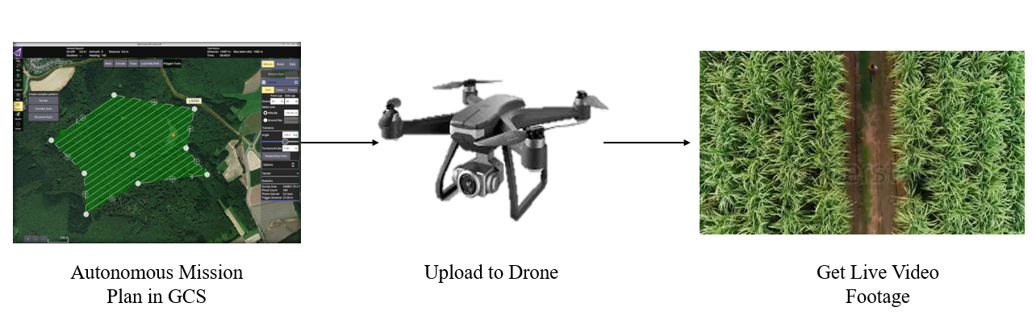
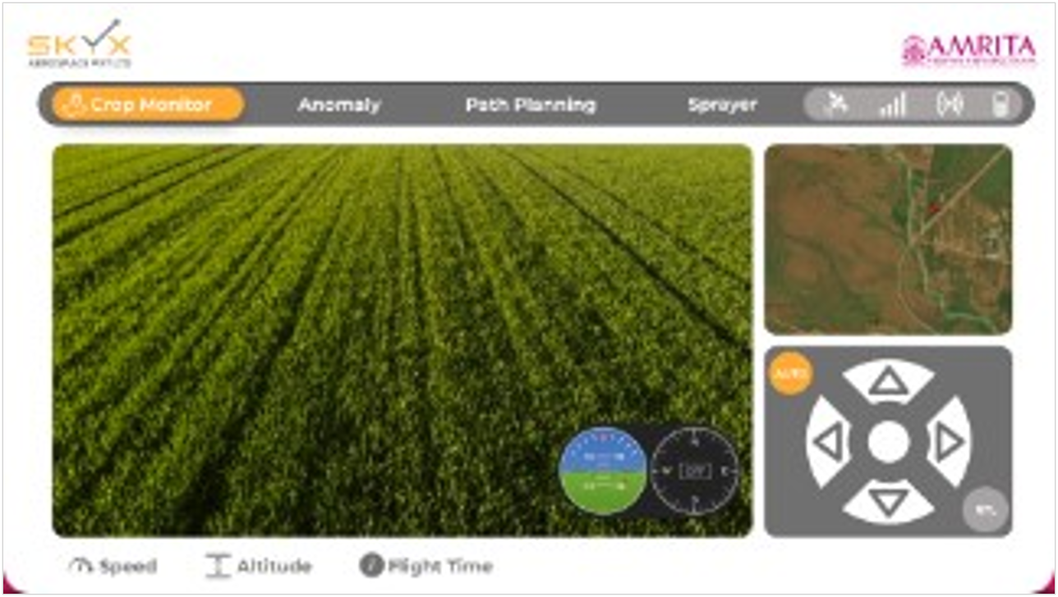
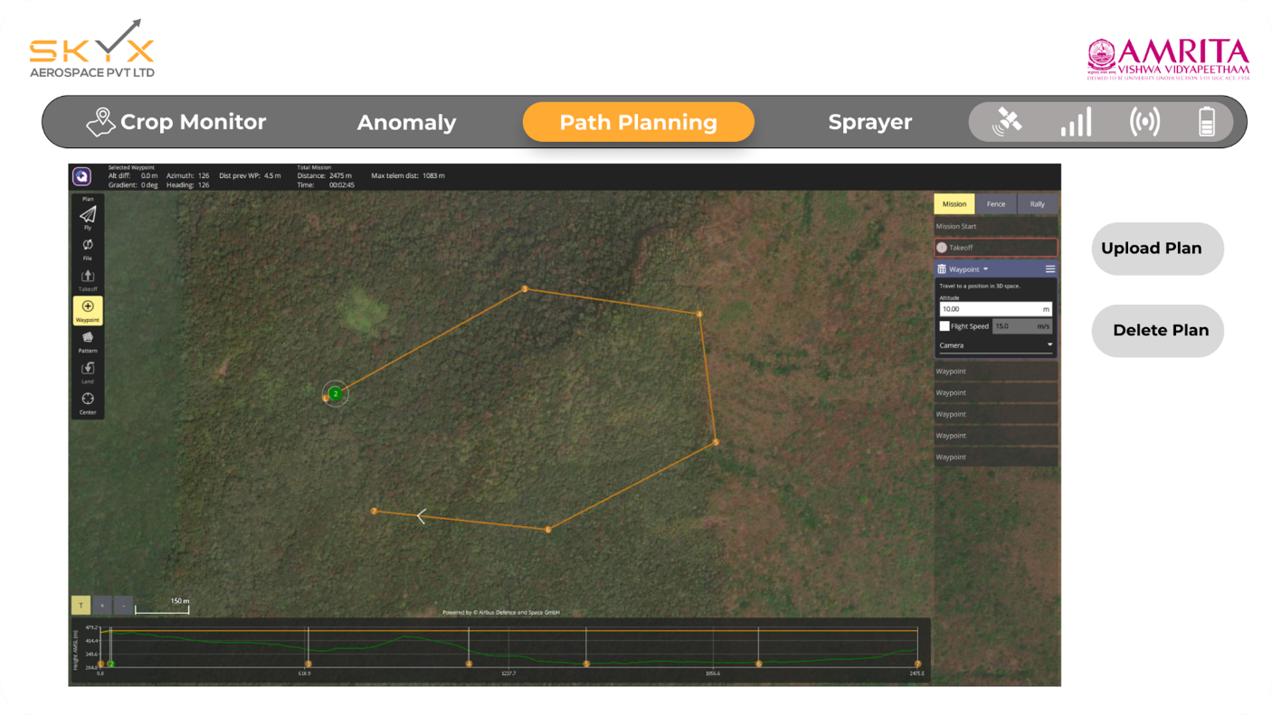
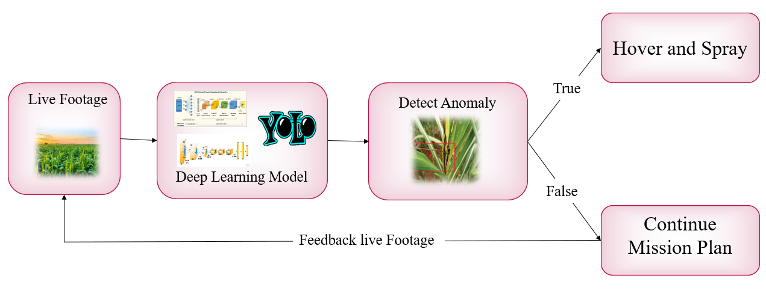
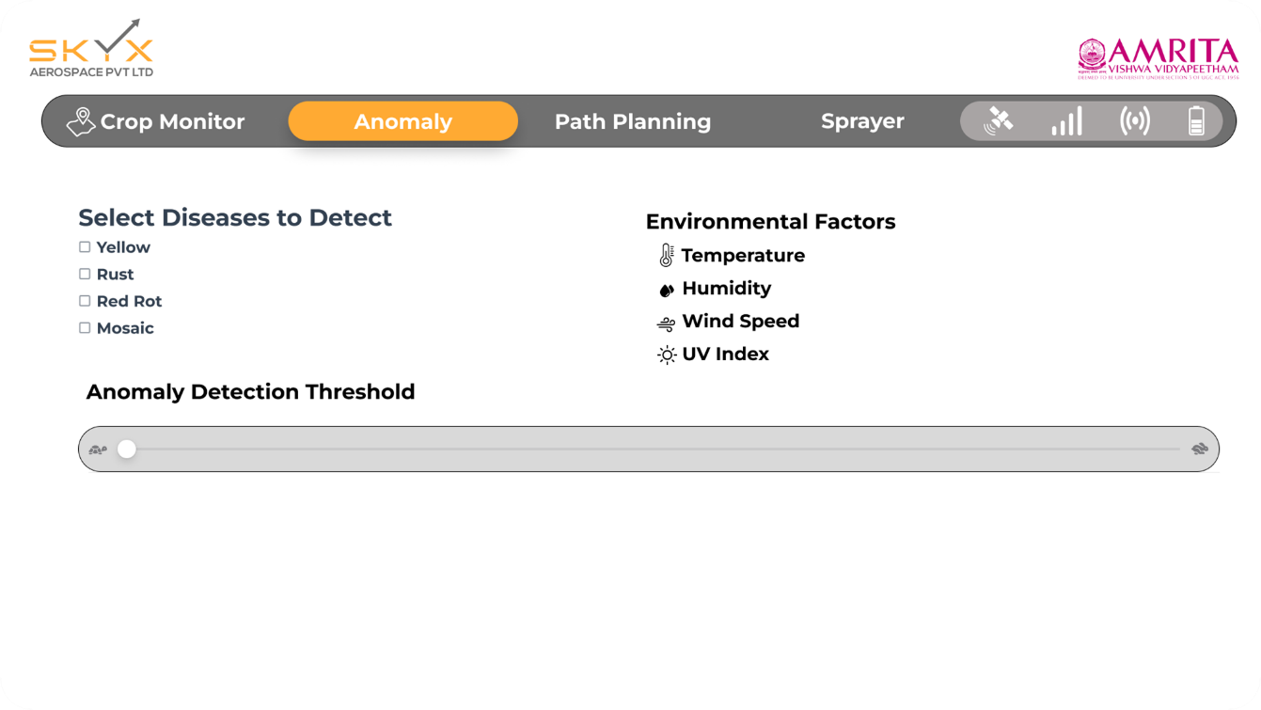
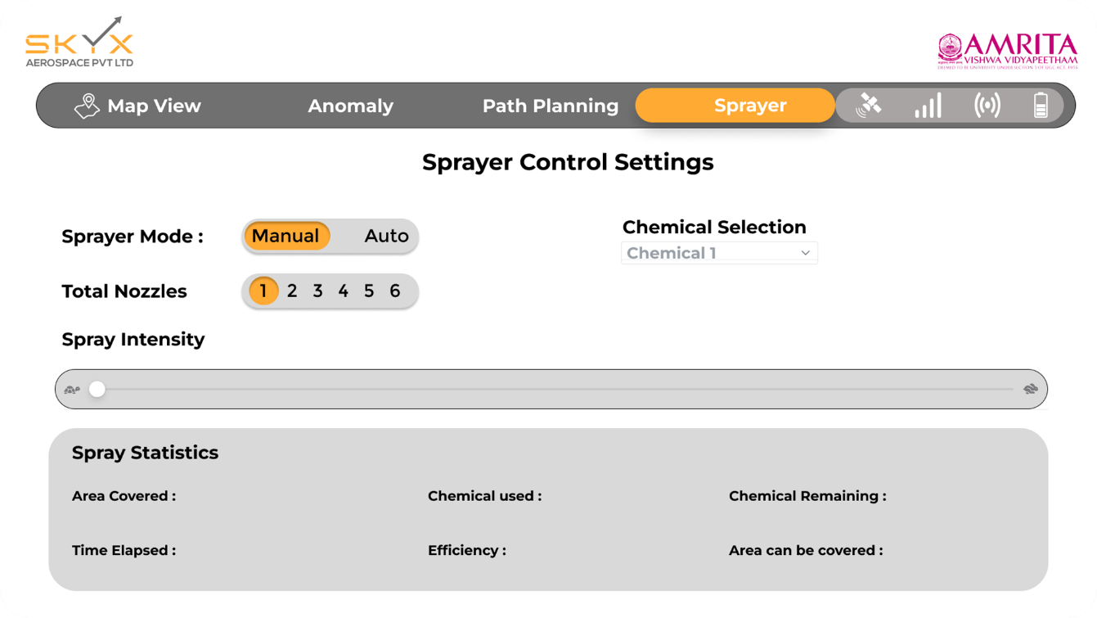
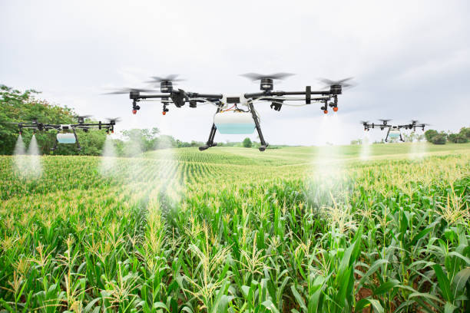
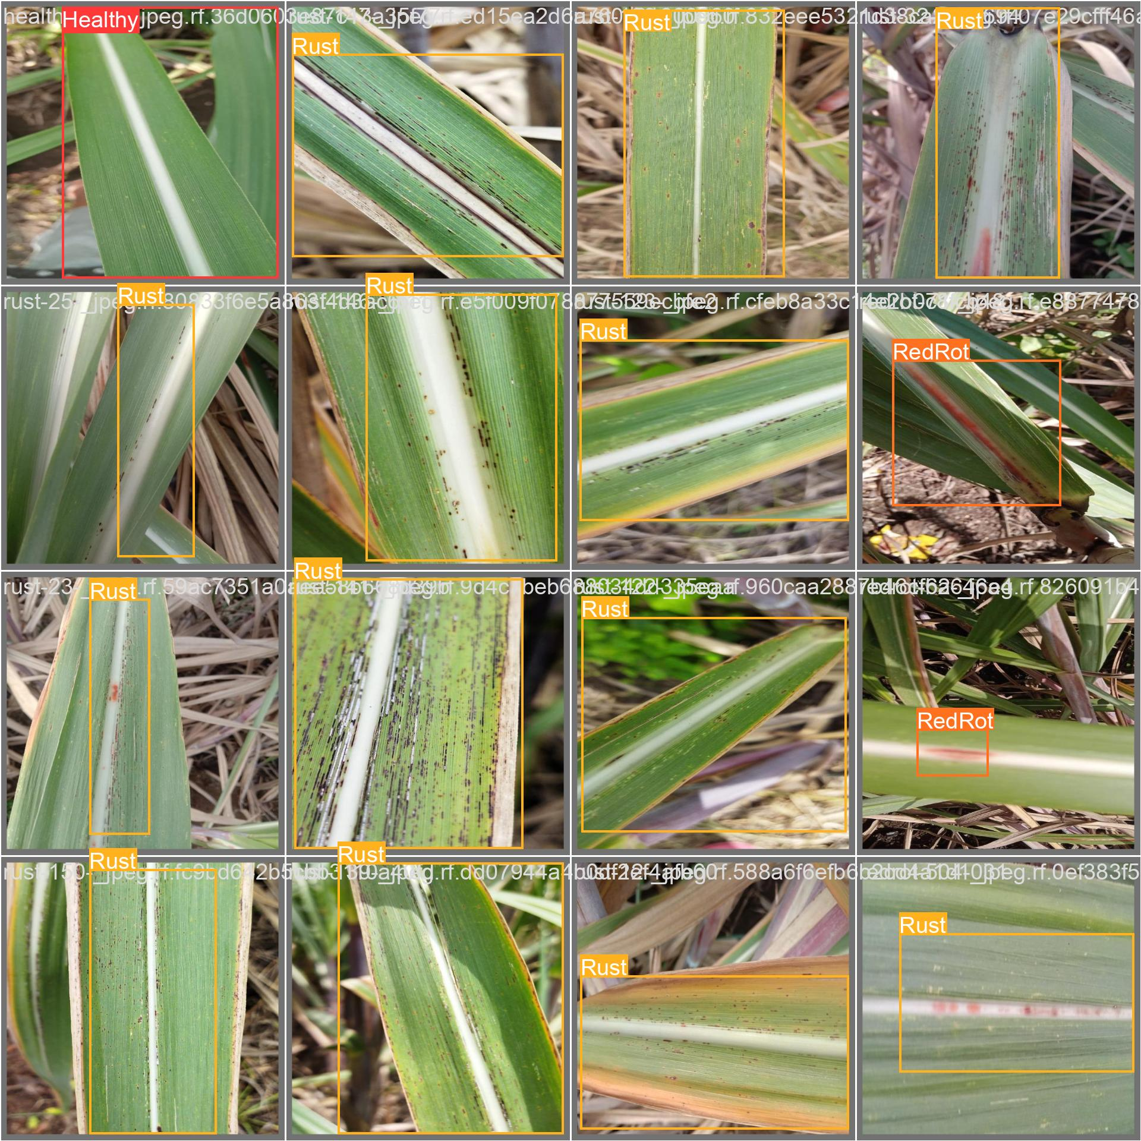
Anomaly Detection in Sugarcane Crop
(A) GOAL & CONTRIBUTIONS
Flight path Generation
Improve crop health monitoring and treatment using Deep learning and drones.Detect crop diseases in real-time while drone is hovering overing the crops:
Identifies sugarcane crop health issues like Mosaic, Red Rot, Rust, Yellow at an early stage..
Reduces labor with regular, accurate drone-based crop health monitoring.
Provides immediate detection and response for timely intervention
Simplifies crop health visualization and path customization for farmers
Supports precision agriculture, boosting yields while conserving resources.
(B) YOLO v8 Architecture
Mission Plannner
QGC
Survey Planning Features:
Polygon area selection with automated waypoint generation
Adjustable flight parameters (altitude, overlap, speed)
Camera trigger points optimization
Advanced Planning Tools:Grid pattern generation with custom spacing
Terrain following capabilities
Real-time mission modification
(E) Drone Setup and GCS
The drone system is built on a reliable quadcopter platform using Pixhawk flight controller, integrated with essential components for autonomous agricultural missions. The setup prioritizes stability, endurance, and precision required for effective crop monitoring..
The user interface is designed for simplicity and efficiency, allowing operators to easily plan, execute, and monitor agricultural missions.
(C) Architecture Diagram
(F) Ground Station App
This view displays a live feed from the drone monitoring sugarcane crops, showing vital data such as speed, altitude, and flight time. The interface allows for real-time tracking of crop health and growth patterns. Users can manually adjust the drone’s position with directional controls for precise field surveillance.
The path planning module allows users to define a flight path for the drone, covering the crop area systematically. The map view shows the planned path overlaid on the field, enabling efficient and complete area coverage. This feature optimizes the drone’s route to minimize flight time and battery usage.
This screen enables the selection of specific diseases for detection, such as rust and red rot, alongside environmental factors like temperature, humidity, wind speed, and UV index. The anomaly detection threshold can be adjusted, allowing users to define the sensitivity of disease detection based on current field conditions.
In manual mode, users can select the number of active nozzles and control the spray intensity for targeted chemical application. The sprayer statistics provide information on the area covered, chemical usage, and efficiency to help manage resources. This mode is ideal for precise, small-area treatments.
(D) Crop Disease Detection
References
Mendoza-Bernal, J., González-Vidal, A., & Skarmeta, A. F. (2024). A Convolutional Neural Network approach for image-based anomaly detection in smart agriculture. Expert Systems With Applications, 247, 123210. https://doi.org/10.1016/j.eswa.2024.123210
Xu, W., Xu, T., Thomasson, J. A., Chen, W., Karthikeyan, R., Tian, G., Shi, Y., Ji, C., & Su, Q. (2023). A lightweight SSV2-YOLO based model for detection of sugarcane aphids in unstructured natural environments. Computers and Electronics in Agriculture, 211, 107961. https://doi.org/10.1016/j.compag.2023.107961
Singh, E., Pratap, A., Mehta, U., & Azid, S. I. (2024). Smart Agriculture Drone for Crop Spraying Using Image-Processing and Machine Learning Techniques: Experimental Validation. IoT, 5(2), 250–270. https://doi.org/10.3390/iot5020013
Attri, I., Awasthi, L. K., Sharma, T. P., & Rathee, P. (2023). A review of deep learning techniques used in agriculture. Ecological Informatics, 77, 102217. https://doi.org/10.1016/j.ecoinf.2023.102217
Aldakheel, E. A., Zakariah, M., & Alabdalall, A. H. (2024). Detection and identification of plant leaf diseases using YOLOv4. Frontiers in Plant Science, 15. https://doi.org/10.3389/fpls.2024.1355941
Ariwa, R. N., Markus, C., Teneke, N. G., Adamu, S., & Fumlack, K. G. (2024). Plant Disease Detection Using Yolo Machine Learning Approach. British Journal of Computer Networking and Information Technology, 7(2), 115–129. https://doi.org/10.52589/bjcnit-ejwgfw6d
Narmilan, A., Gonzalez, F., Salgadoe, A., & Powell, K. (2022). Detection of White Leaf Disease in Sugarcane Using Machine Learning Techniques over UAV Multispectral Images. Drones, 6(9), 230. https://doi.org/10.3390/drones6090230
The input image of the sugarcane crop is first preprocessed using color selection and enhancement techniques to emphasize the leaf areas where disease symptoms are most visible. RGB values are adjusted to highlight the brown or red tones typical of diseases like rust and red rot. Additionally, hue, saturation, and lightness (HSL) values are fine-tuned to improve detection under varying lighting conditions.
After color enhancement, Canny Edge Detection is applied to identify clear boundaries of the leaf areas and detect spots or discolorations indicative of disease. A region of interest (ROI) is defined, focusing on leaf areas where symptoms are most likely to appear. Finally, using a trained object detection model like YOLO, bounding boxes are generated around suspected disease areas. These boxes, labeled with disease types, are overlaid on the original image, allowing for real-time visual feedback of disease presence on the crop.

